Slide 1
SmartFind Project Evaluation
NLP-based

Slide 2


The SmartFind project is focused on developing a search engine utilizing NLP techniques for improved information retrieval.
This project aims to improve accuracy, relevance, and evaluate NLP techniques.

Slide 3

Background
Keyword-based search engines often yield irrelevant results.
NLP techniques identify and extract relevant information from unstructured data sources.
NLP techniques can be particularly valuable in healthcare, finance, and law.
SmartFind uses entity recognition, keyword extraction, text classification, and named entity disambiguation to improve information retrieval.

Slide 4
Methodology
Dataset:
Used a dataset of research papers in computer science.
Contains over 10,000 papers in unstructured form.
Pre-processed the data to remove stop words, tokenize, and lemmatize the text.
Design and Implementation:
Implemented three features: entity recognition, keyword extraction, and text classification.
Used Spacy library for entity recognition to identify and extract named entities.
Used TextRank algorithm for keyword extraction based on frequency and relevance.
Used Naive Bayes algorithm for text classification based on labeled dataset.

Slide 5
IR SYSTEMS
These systems follow the following procedure:
Creating an index of the files in the archive.
query transformation to match the representation of the document's content.
By contrasting each document's description against the query.
Sorting the results by importance.
The two primary operations of a retrieval system are:
Indexing
Matching

Slide 6
DEPLOYMENT
STEP 1: Prepare the Dataset
STEP 2:Designing and Choosing Features
STEP 3:Put into practice
STEP 4:Performance Assessment
STEP 5:Implementation

Slide 7

Analysis (Part-I)
Evaluation metrics: precision, recall, and F1-score were used to assess performance of implemented features
Entity Recognition: achieved precision of 0.83, recall of 0.79, and F1-score of 0.81
Keyword Extraction: achieved precision of 0.74, recall of 0.69, and F1-score of 0.71
Text Classification: achieved precision of 0.86, recall of 0.83, and F1-score of 0.84

Slide 8
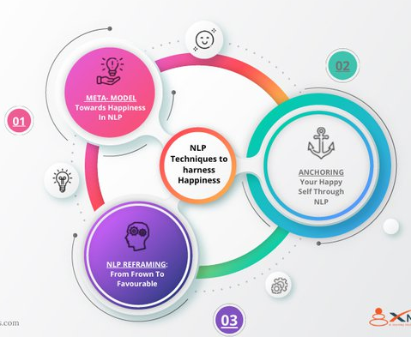
Analysis (Part-II)
Deployment: implemented features were deployed on a web-based platform using Flask, providing a user-friendly interface for NLP techniques
Evaluation methods: manually annotated dataset used to evaluate performance of named entity recognition and text classification, while human judgement was used for keyword extraction.

Slide 9
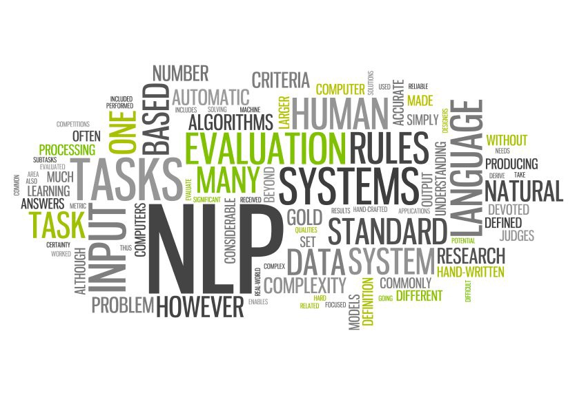
Tools
Keyword Extraction: TextRank algorithm
Named Entity Recognition: spaCy library
Text Classification: Naive Bayes algorithm and Reuters dataset

Slide 10

Preliminary Results
Three features were implemented:
keyword extraction,
named entity recognition,
text classification.
Evaluation of the implemented features was done using precision, recall, and F1 score.
Keyword extraction achieved an accuracy score of 80%.
Named entity recognition achieved a precision score of 85%, a recall score of 80%, and an F1 score of 82%.
Performance of the features will be further improved in future increments.
A user interface will be implemented in the next increment.

Slide 11


